Slide 1
VHDL-Project sp_converter Computer Architecture Practical Training (ERA Praktikum)
Group 53: Marc Sinner – Project Manager
Adrian Kögl – Documentation Manager
Daniel Osipishin – Presentation Manager

Slide 3
Assignment details
Develop VHDL program, that implements a serial-parallel converter
For 18-Bit 44,1 kHz Audio data
Additionally, a testbench with generated inputs

Slide 4
Assignment details
Convert 3 signals:
std_logic FSYNC: 44,1 kHz clock, 1 means current 18-Bit sample is for the left channel, 0 means right channel
std_logic SCLK: a clock with 64 cycles per FSYNC cycle
std_logic SDATA: transmits the sample serially
To 3 new signals:
signed (17 downto 0) LEFTS, RIGHTS: 18-Bit signed integers, transmitting the samples parallely
std_logic FLAG: set when a sample pair is ready, unset when a new one is being converted

Slide 5
Solution approach
Three additional signals:
std_logic_vector (17 downto 0) LEFTMEMO, RIGHTMEMO: output-storing variables
unsigned (4 downto 0) COUNTER: tracks progress of conversion
At every SCLK falling edge, shift LEFT- or RIGHTMEMO (FSYNC 1 or 0) 1 Bit to the left and last Bit becomes current SDATA value: xxxxxxxxxx10110101 → xxxxxxxxx101101010 ← current SDATA old sample remnant new sample
Shifts stop at COUNTER = 18. Counter reset at every FSYNC edge. FLAG set whenever COUNTER >= 18 && FSYNC = ‚0‘

Slide 6
Functionality
Concurrent statements set LEFTS, RIGHTS and FLAG
A process reacts to both FSYNC and SCLK
Falling and rising FSYNC edge sets COUNTER to 0
Falling SCLK edge checks if COUNTER < 18. If so, read 1 Bit from SDATA and increse COUNTER by one

Slide 7
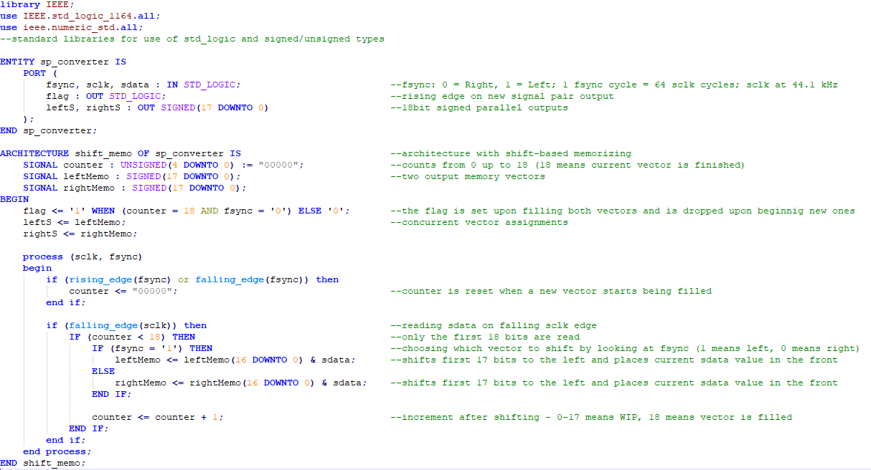

Slide 8
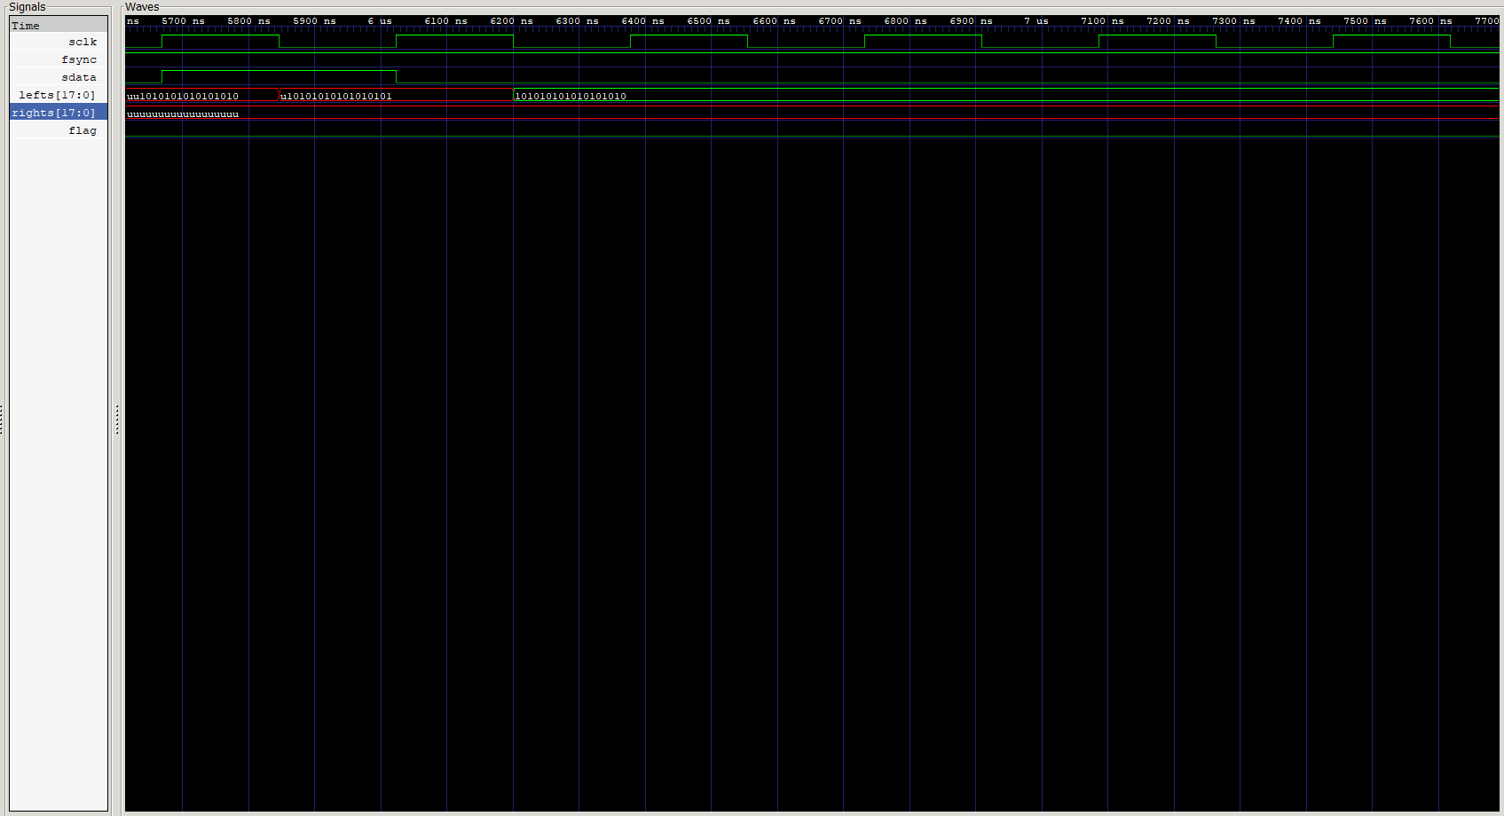
Testbench

Slide 9
Emergence of the solution

Slide 10
Project course

Slide 11
Decisions

